Slide 1
Commvault Update Thursday 1/17/2019
Michael Arpaia, Technical Team Leader
Notes:
[SPEAKER NOTES ARE VERY CLOSE TO THE DELIVERED SCRIPT IN THE VIDEO]
Hello, and welcome to this Commvault Update Video. This was delivered in-person on Thursday, January 17th to the majority of the ASG Inside team members located in Austin TX. This recording may not end up as being hyper-professional from my previous videos, so thank you in advance for your understanding.

Slide 2
Agenda
State of the Business at SHI
Content Catchup and Super-Summary
HyperScale Appliance Demonstration
Latest Technical Enhancements
Notes:
Getting right into it, this preso-to-video will cover…
The current state of the business at SHI, with a focus on SHI’s FY2018-Q4 results;
A catchup on content, with a very high-level summary of what MySHI content was changed last quarter;
A “pre-recorded” reference to the demonstration of the HyperScale HS1300 model appliance – which was presented live by Barry Brown;
…and some details about our updated Service Pack and what that delivers to our Commvault solution.
And just like the on-site delivery, the first three agenda items might seem to jump around and intermingle during this delivery. Don’t worry, that’s by design.

Slide 3
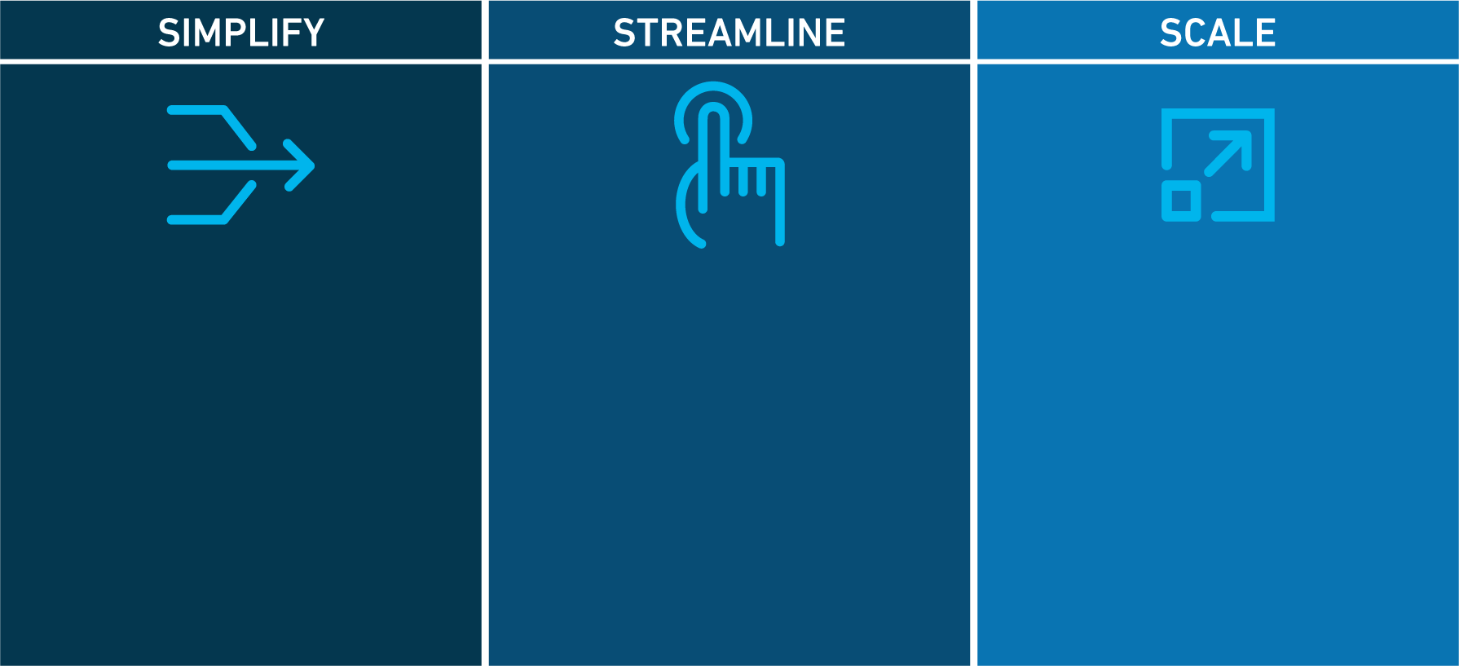
Doing Business With Commvault Today
Making it easier to do business together
Simple packaging
Simple to price
Simple to quote
Align our resources to your diversified needs
Improved communication
Updated Partner Program
Re-designed Partner Portal
Confidently expand your opportunities together
GTM realignment
Help you grow your business
Built with the future in mind
Commvault Advance Public Domain Information https://www.commvault.com/news/2018/may/commvault-announces-new-governance-initiatives-to-support-strategic-transformation-plan
Notes:
For starters, with significant updates to some of my online videos, you will see this slide. Each of my videos talks to how we’ve simplified doing business with us, and how we have streamlined communications in an effort to scale our business together. A great example of this will be showcased in this video.

Slide 4
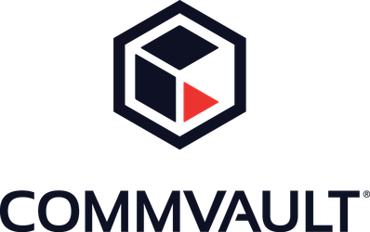
Doing Business With Commvault Today
Customers buy an EXPERIENCE
Customers buy an OUTCOME
Notes:
So, we need to point out something about each of our organizations. SHI has a massive customer base that opens up access to our account teams. In wading through all vendors like us, and staying on top of the technology you are entrusted to sell and position, it’s no surprise that your customers come to you for expertise… looking to buy an experience from you.
As a technology manufacturer, we have a very rich data management solution. Our solution helps customers with some business and technical goal they need to achieve. They may buy products, services, or both to do just that… so in essence, they are looking to buy an outcome from us.
All of our combined efforts over the years, have created a very healthy intersection where we can win business together.

Slide 5
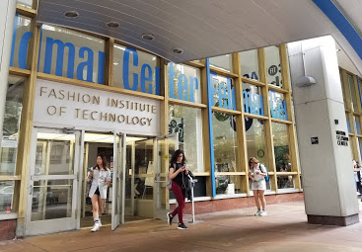
Opportunity Profile (Data Center Refresh & Existing Customer)
Fashion Institute of Technology
Existing Commvault and SHI customer
Pending renewal
Traditional architecture in place
Discovery Results
Needed a hardware refresh
Required additional licenses (true-up on VMs)
Outcome Delivered _________________________________ 127K+
HyperScale Appliance 58TB; +2Y PW; FC & HBA Card __________ 0101K + Markup
Training and Professional services (migration assistance) ________ 0 17K + Markup
Additional software and existing software maintenance __________ 0009K + Markup
Notes:
Here’s one example of an opportunity that we closed in your FY2018-Q4… The Fashion Institute of Technology.
This deal was transacted on December 12th, and this joint customer of ours has invested in Commvault’s software and SHI’s position as the reseller who transacted that business. With a pending renewal on the horizon, they realized that they needed to upgrade their internal Commvault deployment, and add new software licenses for their virtual environment.
With some fact finding and positioning, we were teed up to position our HyperScale Appliance for the hardware upgrade, and include training, installation and migration services, and the extra VM licenses over top of their renewal. In terms of net-to-Commvault value, this was a 127K win for us.

Slide 6
Opportunity Profile (Data Center Refresh & Existing Customer)
Install Base (Spans 3 Years in CORP)
368
Discovery Topics
Age of backup hardware/infrastructure vs. production hardware/infrastructure;
Retention and restore capabilities vs. size, scope, and scale of production data.
Projected Conversion Rate (10% & $100K net-to-CV per transaction)
$3,600,000+ Markup
Notes:
That was just one of about 100 transactions made last quarter… and it begs the question, how many more opportunities are out there that fit this profile.
Well, there are over 800 customers that have SHI as the incumbent partner, that made a Commvault purchase in the last 3 years. We further broke that down to get 368 total clients across SMB, CIN, and CFN lines of business, that fit this profile.
Now, you are all internally trained to have data center conversations with customers. By simply leaning on your own skills, you can uncover a need for a customer to upgrade their underlying Commvault infrastructure. A few high-level example discovery topics are here.
Let’s take that F.I.T. win from before as a metric, and maybe chop it down a touch to a round number of 100K.
Now let’s say in the course of 2019, you can successfully convert 10% of this install base to upgrade their internal infrastructure to a HyperScale appliance, that’s a net-to-Commvault footprint of $3.6M, PLUS your markup!

Slide 7
Certification vs. Readiness
Certification
Structured training to meet a specific objective
Almost always measured and trackable
→ Requirements to Commvault’s Partner Program (Keep top-level discounts)
Readiness
Structured training to develop skills
May be measured and trackable
→ External training to deliver cross-functional skills and better outcomes
Notes:
So, to side-step a minute, for those of you who know me… I make a clear distinction about certification and readiness.
For me, formal certification delivers core information about a solution or offering from a vendor like us. It makes it easy to track who is taking these certifications, and measures a certain level of commitment. Now in my opinion it’s a good measurement, but not perfect in any way. At best, our Partner Program can capitalize on the tracking, to create a subset of terms and conditions that must be met to obtain the best possible discounts for deal registration.

Slide 8
Certification vs. Readiness
Certification
Structured training to meet a specific objective
Almost always measured and trackable
→ Requirements to Commvault’s Partner Program (such as keeping top-tier discounts)
2017 2018 2019
17 17 3
69 20 6
This is a comparison of attained certifications to one of your fiercest competitors.
2 - Enterprise
16 - Enterprise
1 - Enterprise
2 - Program
1 - Program
2 - Program
13 - Corporate
Notes:
And over the years, as the certifications have come and gone, we can see the number of the basic Commvault Technical Sales Professional certifications have been achieved by SHI personnel, broken down by key organization (CORP, ENTERPRISE, and FUNDED HEAD PROGRAM PERSONNEL).
It should be no surprise that we track all partners globally… take this example from an “unidentified fierce competing reseller” of yours.

Slide 9
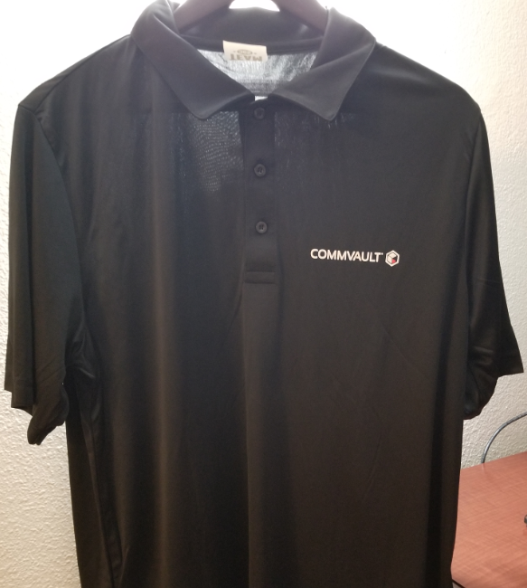
Certification vs. Readiness
Certification
Structured training to meet a specific objective
Almost always measured and trackable
→ Requirements to Commvault’s Partner Program (such as keeping top-tier discounts)
CERTS FOR SHIRTS
Get two Commvault lightweight polo shirts when you obtain your CVTSP19 certification.
For how to access the training, contact marpaia@commvault.com or barry_brown@shi.com.
Notes:
So, as an incentive, anyone who obtains their updated Commvault Technical Sales Professional Certification for 2019, I will get you 2 lightweight golf-style polo shirts. Upon completion, I will ask you for your size and the address you would like them shipped to if you’re not based in Austin TX.

Slide 10
Certification vs. Readiness
Certification
Structured training to meet a specific objective
Almost always measured and trackable
→ Requirements to Commvault’s Partner Program (such as keeping top-tier discounts)
Readiness
Structured training to develop skills
May be measured and trackable
→ External training to deliver cross-functional skills and better outcomes
Notes:
Getting back to the comparison from a few minutes ago… we’re now going to focus on readiness.

Slide 11
Certification vs. Readiness
Commvault Solution
Architect
Readiness
Structured training to develop skills
May be measured and trackable
→ External training to deliver cross-functional skills and better outcomes
CVLT & SHI: Better Together
CVLT Appliance Lineup
CVLT
Licensing
Fast Track
Tech Training
Commvault Technical Sales Professional
Lunch &
Learn Series
Solution Card Review Session
Data Center Survey Asset
List Price &
SKU Generator
Storage
Retention Estimator
Visualization
Kit (PPTX)
Commvault Workshop Sessions
Survey to Architecture Design – Storage Retention Estimator Deep Dive – Build a Commvault Infrastructure Server
PLAN LEGEND
READINESS TRAINING
FORMAL CERTIFICATION
ASSETS AND TOOLS
WORKSHOP SESSIONS
Notes:
For me, readiness is training specifically designed to help you be effective on calls, or in person, so that you can have a better conversation with a customer, giving them a better experience with you.
Over the years, I’ve reshaped all my training to be as short as possible, effective, and not lose too much depth. Also, following a readiness regimen, you can give yourself some experience and practice even BEFORE you engage in a customer conversation. This chart is a high-level overview of what myself, Barry Brown, and my field team can deliver for you.

Slide 12
Certification vs. Readiness
OCTOBER – NOVEMBER – DECEMBER 2018 REVENUE NUMBERS
$3,984,468 Same fiercest competitor as previously not mentioned by name!
$3,861,468 SHI
$0,123,230 DELTA!
Readiness
Structured training to develop skills
May be measured and trackable
→ External training to deliver cross-functional skills and better outcomes
Notes:
So now let’s marry all this content together.
Just like certification, we track transactions. The same unnamed vendor that was discussed previously, had new license and appliance revenue a just a little bit under $4M in Q4. SHI had just over $3.8M. The result
The difference between the previously unnamed vendor and SHI’s new license revenue for Q4, was a mere $123,230!
Now… remember the $127K deal with F.I.T.? A bit over $100K of that was new license and appliance revenue.

Slide 13
Making One
Deal Matter
Notes:
In a nutshell – that’s one deal. Imagine making one deal matter…

Slide 14
Making One
Joint Commvault-SHI Client
with a Pending Renewal
and a Hardware Refresh
to Consider an Appliance
Deal Matter
Michael Arpaia
Technical Channel Leader
Commvault Systems
Notes:
…more specifically, making one joint client, with a pending renewal, that needs a hardware refresh, considering an appliance deal, matter!
Now that’s reality… And that’s the experience you can deliver… And the outcome we can deliver for our joint customers.

Slide 15
Net-New Appliance Transfer Prices w/Approved Deal Registration
Please Note: These vendor-approved prices do not include any professional services, training, or SHI markups to the customer.
Model RO1100: Remote Office Appliance
4.5TB
Base hardware & software licenses for physical server, virtual server, on-premise applications, and NAS data protection options. An approved Commvault deal registration is required.
$18K
29TB
Base hardware & software licenses for physical server, virtual server, on-premise applications, and NAS data protection options. An approved Commvault deal registration is required.
Model HS1300: HyperScale Appliance
$81K
174TB
Base hardware & software licenses for physical server, virtual server, on-premise applications, and NAS data protection options. An approved Commvault deal registration is required.
$396K
Model HS3300: HyperScale Appliance
RO1100 is not a HyperScale Appliance and cannot be added to an existing HyperScale Appliance or HyperScale Reference Architecture for added resiliency within the storage pools mapped to the HyperScale devices.
Notes:
Now, it’s worth pointing out that net-new appliance opportunities are out there too. These are transfer prices for a few of our appliance models, based on an approved deal registration.

Slide 16
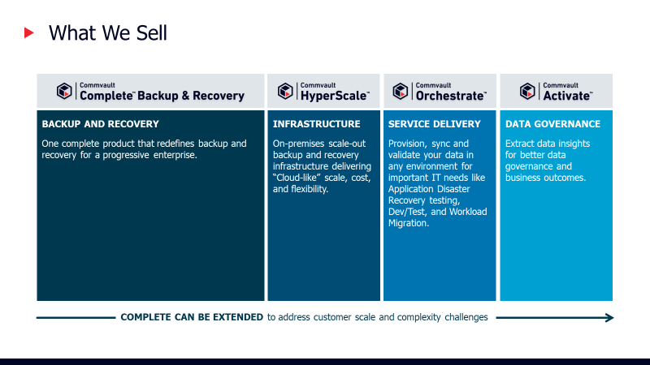
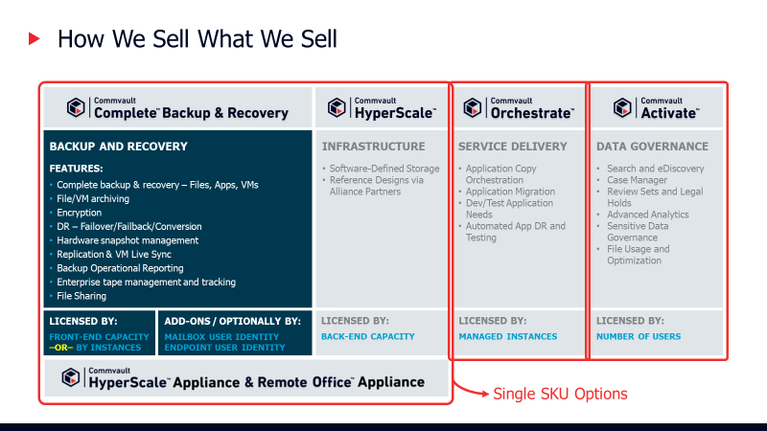
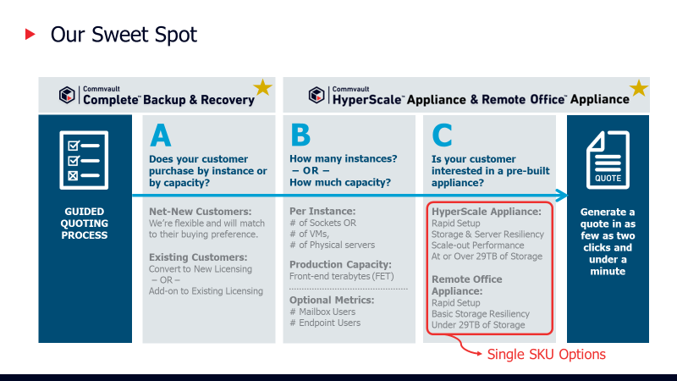
Simple Messaging
Notes:
The videos I’ve published are designed to go through the tactical selling motions to help you frame up how an appliance may fit into a customer’s environment.

Slide 17
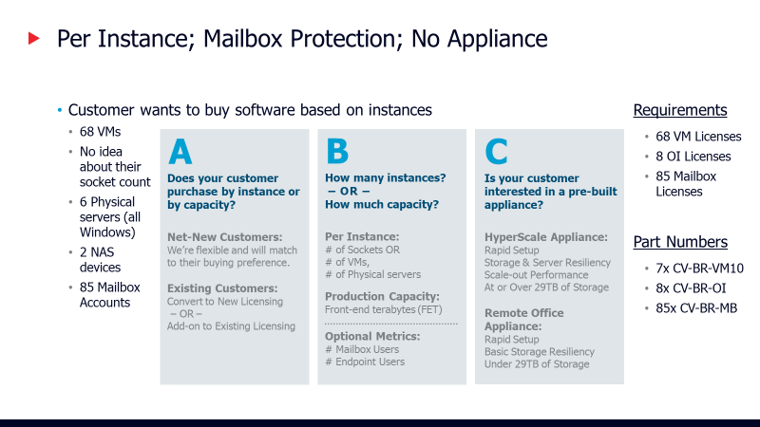
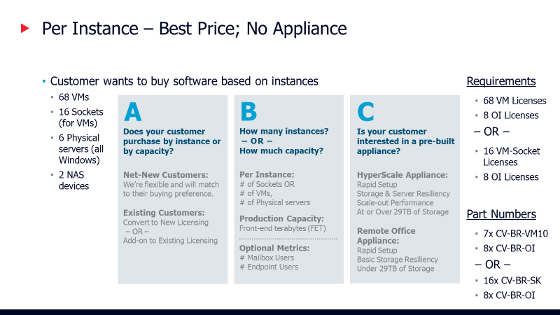
Net-New Business Examples
Notes:
My posted videos include several scenarios to help give you some experience before your engagement. And if you ever need a refresh, all three key videos can be consumed in less than 20 minutes.

Slide 18
Commvault’s HyperScale Appliance Demo BARRY BROWN SHI-BADGED TECHNICAL LEADER FOR COMMVAULT Please reference the recorded presentation in place of the live demo conducted in person: https://teams.myshi.com/cs/asg/Documents/cv_hs1300_demo.mp4
Notes:
So now that you just watched the pre-recorded demonstration of the HyperScale Appliance, it’s good to know that we’ve been in the Appliance business a long time. Our previous appliance was a marriage between HPE and NetApp, and prior to that was a 5 year run with DELL.
It’s also good to know that appliances is just one facet of our portfolio.

Slide 19
THE COMPETITIVE DATA PROTECTION LANDSCAPE
Data Management Feature | Commvault Backup and Complete | IBM Spectrum Protect | Veritas | Veeam | Rubrik | Cohesity | Druva
Backup & Recovery | Supported/Included | Supported | Supported | Additional Product(s) | Limited/Add-on | Limited/Add-on | Limited
Snapshots & Replication | Supported/Included | Limited | Limited | Limited | Limited | Limited | Not Supported
Premium Reporting | Supported/Included | Additional Product | Additional Product | Additional Product | Additional Product | Additional Product | Limited
File & VM Archiving | Supported/Included | Not Supported | Additional Product | Not Supported | Not Supported | Not Supported | Limited
Live VM Replication | Supported/Included | Not Supported | Not Supported | Supported | Not Supported | Not Supported | Not Supported
Any Target: Disk/Cloud/Tape | Supported/Included | Limited | Limited/Add-on | Limited | Limited | Limited | Limited
Advanced Tape Management | Supported/Included | Limited | Supported | Limited | Additional Product | Additional Product | Not Supported
Deduplication & Encryption | Supported/Included | Additional Product(s) | Additional Product(s) | Additional Product(s) | Limited | Limited | Supported
Mailbox Protection | Supported/Standalone Option | Additional Product | Supported | Additional Product | Limited | Limited | Supported
Endpoint Protection | Supported/Standalone Option | Additional Product | Additional Product | Additional Product | Not Supported | Not Supported | Supported
WHAT A COMMVAULT SOLUTION PROVIDES
A Complete Backup & Recovery Solution: Coverage for all workloads – physical, virtual, cloud, hybrid, applications, files, etc.
A Virtual Repository: Automated, scalable, direct, and instant access via native APIs, anytime/anywhere data availability.
4D Index: Powerful multi-dimensional index, augmented by Artificial Intelligence, to better understand and utilize your data.
Artificial Intelligence: Built-in machine learning to improve operations, monitoring, and alert response.
Automated Policy Engine: Manage the data based on SLA, global data policy management.
Notes:
Sometimes over-focusing on one thing makes it seem we are one dimensional. Take this quick competitive grid – which can also be found on the MySHI directory. You’ll see Cohesity and Rubrik are on the list, and they are effectively Appliance companies. Veritas is on the list, and they’ve also been in the appliance business. IBM and Veritas, can simply sell software-only solutions. We can also target specific technical areas such as virtual machine protection (like Veeam), and endpoint protection (like Druva).
What if a client has a mix of on-premise servers, on-premise VMs, a few cloud instances running in the cloud, is also using Office 365, and has a mobile workforce with tons of people using company-issued laptops? Not one company from this list is able to come close to supporting all of these capabilities, with a product set that was developed to work together from the start, completely integrated from the ground up.

Slide 20
Commvault IS ABSOLUTELY MORE Than Just One Thing
Flexibility
We have the ability to deploy our software in a number of ways that works with customer environments that support on-premise and cloud based data center operations.
Adaptability
We have the appropriate licensing programs and technology capabilities to allow a customer to invest leverage their existing solution, even during a data center refresh.
Commvault Appliances
Bring-Your-Own-Server
Deploy in Cloud
4.5TB – 14.5TB
29TB – 87TB
174TB – 261TB
1x Up to 500TB
2x Up to 1000TB
4x Up to 2000TB
Model RO1100: Remote Office Appliance
Model HS1300: HyperScale Appliance
PLUS
Model HS3300: HyperScale Appliance
Notes:
So it should be pretty easy to see, that we’re not just one thing. Our portfolio of solutions, and the way we go to market with multiple options, allows out customers to buy into a solution with flexibility, and adaptability.
Customers can purchase our own brand of appliances, they can buy-and-build their own traditional architecture solution, and they can deploy Commvault infrastructure in the cloud.

Slide 21
Alternative Purchase Routes
HPE Complete with HPE
Commvault Complete Backup and Recovery deployed on HPE hardware (Apollo / DL380).
Pricing is available through HPs Global Price List.
Commvault items count towards program requirements for HPE and Commvault.
Server nodes with 24 drive counts available in 4TB, 6TB, 8TB, 10TB, and 12TB sizes for scalable storage pools.
ScaleProtect with Cisco UCS
Commvault Complete Backup and Recovery deployed on Cisco UCS hardware.
Pricing is available through Cisco’s Global Price List.
Commvault items count towards program requirements for Cisco and Commvault.
Server nodes with 24 drive counts available in 4TB, 6TB, 8TB, 10TB, and 12TB sizes for scalable storage pools.
Notes:
Now, for customers that want to purchase their HyperScale infrastructure with brands they are completely entrenched with – namely HPE and Cisco – we have tested and verified configurations that a customer can purchase from these vendors. In addition, when a customer purchases their Commvault software licenses from HP’s or Cisco’s price lists, SHI will receive program benefits from the vendor they made the purchase from in addition to Commvault.

Slide 22
High Level Selling Motions
Backup to public cloud
Backup within public cloud
Backup across public clouds
DR & replication of VMs in the cloud
Rapid setup and teardown of VMs
Platform migration to public cloud
Notes:
With all this information – and some practice – you’ll be able to support these key selling motions, and assist your customers with the experience they need, helping to deliver the outcome they deserve.

Slide 23
New Capabilities in SP14
Notes:
So let’s get into a little bit of the updates for our latest software update – service pack 14.

Slide 24
But Before We Do That… Commvault Service Pack Cadence
Service Packs are cumulative patches and updates that come out every three months (sometimes with hot-fixes in between months);
We fully support the current, and past 4 service packs before support EOL;
Rough Schedule: 15-MAR 15-JUN 15-SEP 15-DEC
Details in public domain and on MySHI in the Customer Facing folder.
Notes:
Just as a side note, Commvault operates on a regular cadence to deliver these updates to our customers. Every mid March, June, September, and December, we deliver patches, updates, and new capabilities with each service pack.

Slide 25
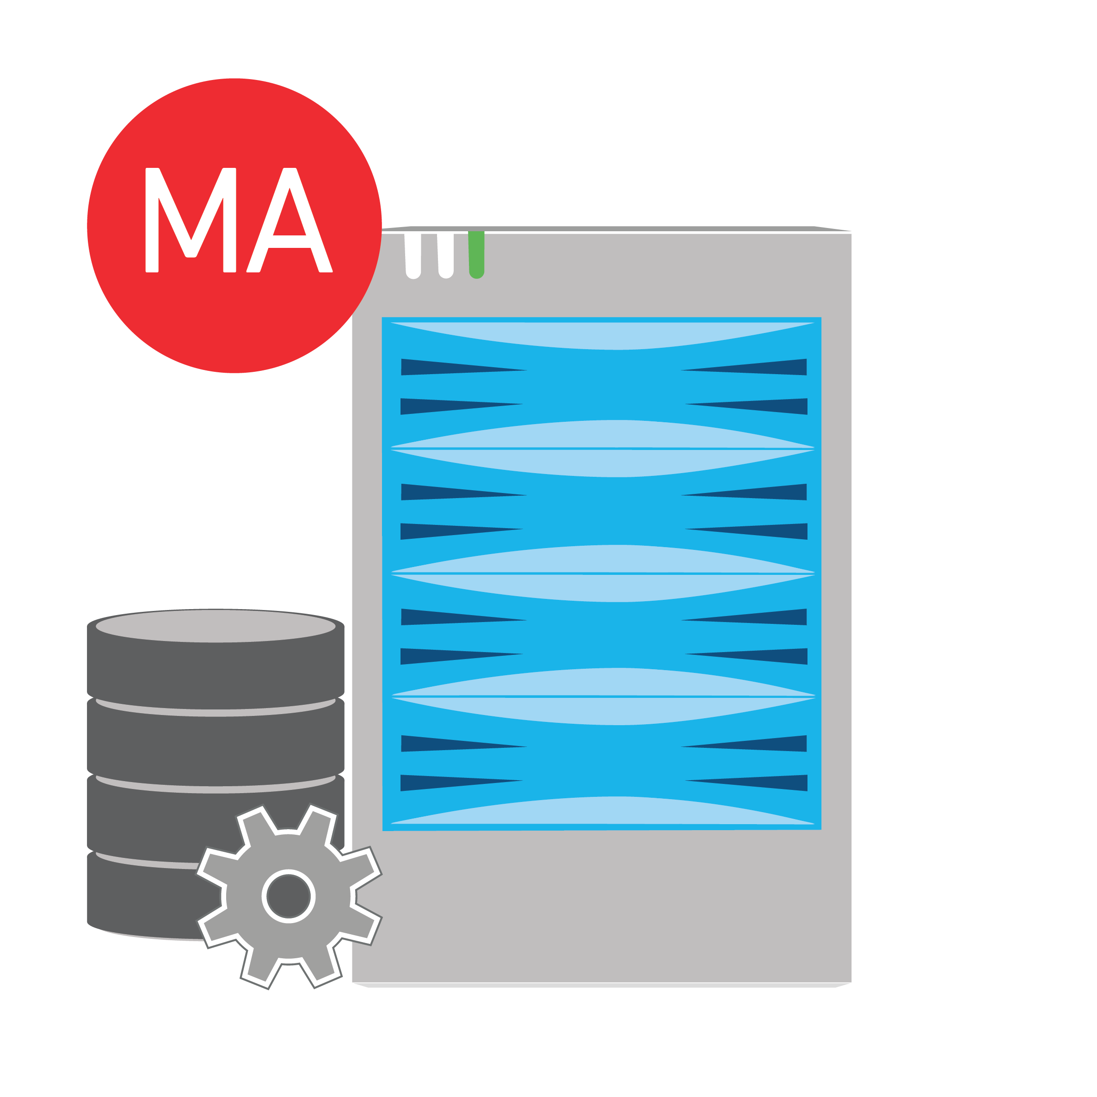
Media Agent Recordkeeping
SP14 DEEP TECHNICAL: Enhancements to Data Deduplication
OR
Index Cache
Deduplication Database
A ledger of every file and object
Name
Attributes
Where it came from
When it was protected
How it was protected
Where it is going (disk/cloud/tape)
Access Requirements
Backup / Archive operations
Cleanup / Data Aging operations
Browsing operations
Restore operations
A ledger of every data block
Unique block signature
Number of times a signature is identified
Tied to a common set of storage policy rules
Access Requirements
Backup / Archive operations
Cleanup / Data Aging operations
Notes:
The most notable, deep-technical highlight is the advancements in Commvault’s data deduplication efficiencies.
If you have taken my Fast Track Technical Training session, you will know the Media Agent has two critical databases it uses. The Index Cache – which is a ledger of every file that is protected by Commvault; and the Deduplication Database – which is a ledger of every contiguous block of data written to disk or cloud storage.
As a quick reminder, the Index Cache is required to be accessed during any protection, cleanup, browsing, and restore operation. The Deduplication Database is required to be accessed only during protection, and browsing operations.

Slide 26
Deduplication Database Requirements: Before SP14
SP14 DEEP TECHNICAL: Enhancements to Data Deduplication
Underlying Configuration
Deduplication Database #1
The more DDB space allocated, the more back-end disk / cloud storage you could write to.
The more back-end disk / cloud space you need to write to, the more CPU, RAM, and Index Cache disk space you need.
The more resources your server needs, the more expensive the server becomes.
One Set of Storage Policy Rules
How long to keep the data around per asset
Typically tied to one type of dataset
Bulky requirements
One Set of Storage Policy Rules
How long to keep the data around per asset
Typically tied to one type of data set
Bulky requirements
Deduplication Database #2
Notes:
Prior to service pack 14, deduplication databases were a heavy anchor concept. Storage policies with retention policies and storage assets are tied together, and are managed as one large contiguous set. The engineering behind this has a ripple effect on the physical requirements of the Media Agent. Consider these concepts:
The requirement for physical storage on disk and cloud targets → means you need a Media Agent with the right requirements… specifically Deduplciation Database capacity
With more DDB capacity needed → you need more physical resources on the Media Agent
And the more resources required for the Media Agent → the more expensive it will be to run that Media Agent (and that’s both on-premise and in the cloud).

Slide 27
Deduplication Database Requirements: Now in SP14
SP14 DEEP TECHNICAL: Enhancements to Data Deduplication
Underlying Configuration
Multiple Deduplication Database Parts
The more DDB space allocated, the more back-end disk / cloud storage you could write to → EVEN MORE!
The more back-end disk / cloud space you need to write to, the more CPU, RAM, and Index Cache disk space you need.
The more resources your server needs, the more expensive the server becomes.
Multiple Sets of Storage Policy Rules
How long to keep the data around per asset
Not bulky in nature, making resources needed to manage this more effective.
Sizing measurements are still tied to total size.
Lighter resource requirements allows the server to manage MUCH MORE BACK END STORAGE.
Notes:
Now, none of these concepts change at all with SP14!
However, we’ve changed internal recordkeeping logic so that the load on the physical server is greatly reduced. One storage policy with retention requirements is still managed as one large entity, but the database is now paired down and tied to per-job references. Untimely, this reduces the amount of work the Media Agents need to perform basic tasks. This allows a Media Agent to be able to handle even more back-end storage using similar physical requirements.
As a point of reference: An extra large Media Agent with a single DDB had a documented back-end disk library load of 200TB. Today, that same extra large Media Agent can handle a 250TB back-end load.

Slide 28
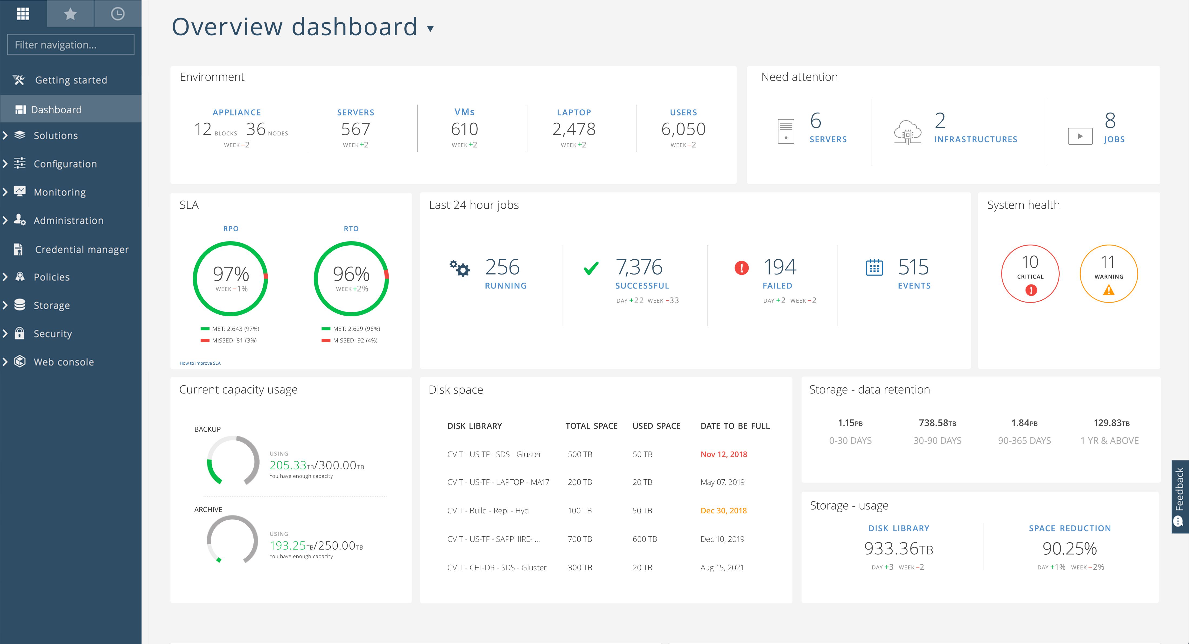
Admin Console is now the Command Center
SP14 LIGHT TECHNICAL: Visual Enhancements with a Name Change
Coverage
& Trends
Focus
Attention
Overall Health
SLA Key Performance
Daily Operational Performance
Data Retention
Capacity Usage
Monitor
Overview
Appliance / Storage
Orchestration
Workloads
Critical Disk Space Resources
Storage Utilization & Dedupe Effectiveness
Notes:
Now we head to some updates to the user interface.
Our dashboard-style administrator interface is full of information that’s easy to view and drill down into. This overview dashboard showcases key coverage metrics, operational performance, and all the information about licensed capacity and managed capacity, including deduplication effectiveness.
While a bit more of a marketing adjustment, the Admin Console has been renamed to the Command Center.

Slide 29
More Complete Protection…
SP14 ADDED FEATURES: More Protection Options
Alibaba RSD (Relational Database Service) for MySQL and PostGres
End users can restore the data to the same Alibaba RDS instance that you backed up, a new Alibaba RDS instance, or on-premises database instance, including table level restores
Google Cloud Storage Backup for Windows and Linux VM Connectors
Data can be restored to a supported file system hosted by Windows or Linux, back to the same Google Cloud account (instance), a different Google Cloud account, or a different cloud storage target altogether (Amazon S3, Azure Cloud, Oracle Cloud, etc.)
Apache Hbase backups on the Haddoop platform → Big Data support add-on
Restore block-level volumes for PostGres with multiple streams → Faster restore times
Restore data from a MySQL Standby Server from block-level backups or IntelliSnap snapshots → Faster restore times
Cassandra Commit Log backup and restore → Big Data support add-on
Command Center Integration → Ease of use for backup and restore administration
Includes Microsoft SQL Server, Microsoft Active Directory, and Oracle RAC Database support
Notes:
Service Pack 14 also adds some features, and capabilities to the complete Commvault solution. Please review this content on your own, or download the “Service Pack 14” newsletter on MySHI.

Slide 30
More Complete Protection…
SP14 ADDED FEATURES: More Protection Options
Cisco HyperFlex Storage Array / VMware Backup Configuration
When you perform IntelliSnap backups with the Cisco HyperFlex storage array, the backup takes a hardware snapshot of each virtual machine (VM) designated for protection, instead of taking snapshots of the entire datastore that hosts the VMs.
Supported capabilities include Streaming backup, Live Sync from streaming backup, IntelliSnap backup and backup copy, Full VM restore, VM file(s) restore.
VMware Replication Using VIAO (Live Sync I/O Block Replication)
vSphere APIs for I/O Filtering (VAIO) is a framework that enables block-level replication of virtual machine data. The Live Sync I/O feature uses block-level replication to continuously stream updates from source to destination VMs.
Virtual Machine File Indexing for Windows VMs
With file indexing for Windows VMs, you can search virtual machine backups by file name and other attributes, and view the data distribution by hierarchy or file size (backup to disk only).
Supported Hypervisors include AWS (streaming backup and IntelliSnap operations), Azure IntelliSnap operations, and VMware streaming backup operations.
VM Centric Operations for VSA with VMware
Granular control of auto-discovery, auto-setup of backup policies, data aging, and security settings.
Notes:
((Service Pack 14 also adds some features, and capabilities to the complete Commvault solution. Please review this content on your own, or download the “Service Pack 14” newsletter on MySHI.))

Slide 31
Critical Assets and Resources for SHI
What we reviewed in this presentation
Link to the Commvault Solution Card (External)
Link to the Commvault Appliance Lineup Video
Link to the Commvault Licensing Video
Link to the Data Center Survey Tool
Link to the Storage Retention Estimator Tool & Training Video
Additional links and content
Link to the Commvault & SHI: Better Together Video
Link to the Commvault Complete List Price & SKU Generator Tool & Training Video
Link to the Commvault Competitive Grid
Link to the Virtualization Kit Presentation Toolkit
Link to the Commvault Partner Portal for access to the Partner Success Desk Access, Current Competitive Content, Partner University Technical Training Access, and more.
Notes:
((Key references on MySHI, reiterated here as the focal ramp or re-ramp point.))

Slide 32
We will drive content and continuing education for you.
Austin Team and Field Resources – Post Recording
Let us know what you are looking for! Send an email to the team… shi@commvault.com
Schedule in-person, remote readiness sessions, CVTSP19 prep
Send an email to the team… shi@commvault.com
Direct to me… marpaia@commvault.com
Direct to Barry Brown… barry_brown@shi.com
Schedule HS1300 demos inside the CIC
Direct to Barry Brown … barry_brown@shi.com

Slide 33
Thank You
Michael Arpaia, Technical Team Leader

